Slide 1
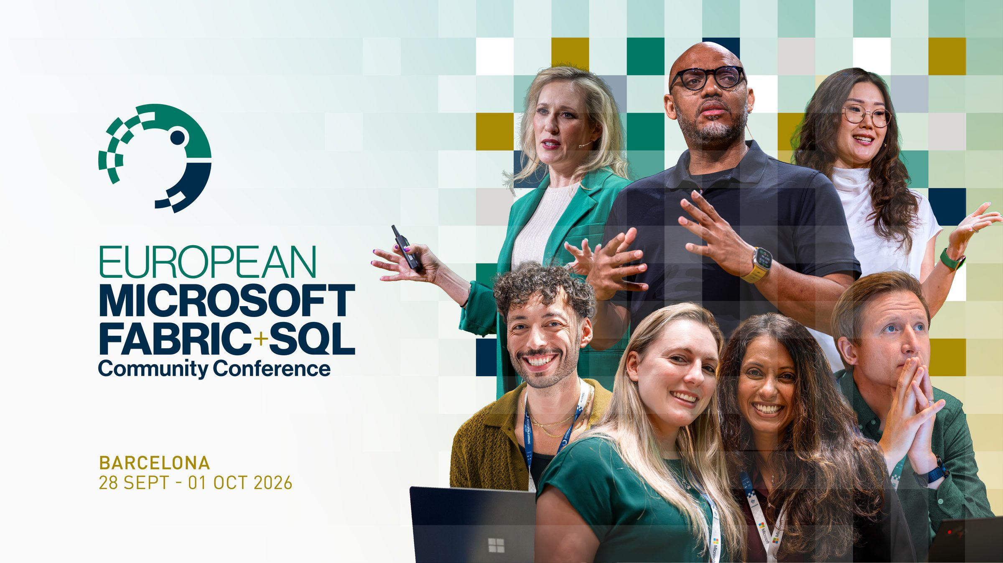
Notes:
Hold on the splash while the room settles. The simulator is already streaming in a terminal on the second screen.

Slide 2
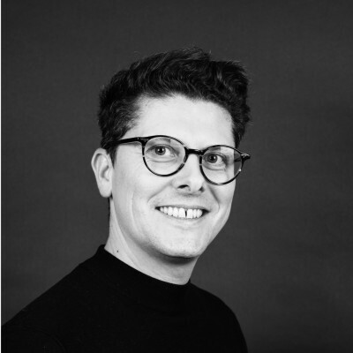
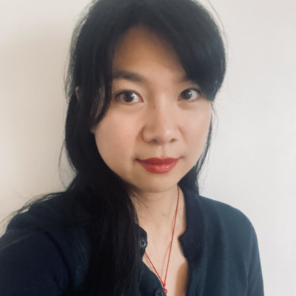


Do not record or livestream this session
MICROSOFT FOUNDRY REAL-TIME INTELLIGENCE · LEVEL 300
FABRIC IQ + FOUNDRY IQ:
WHAT 'CONNECTED' ACTUALLY LOOKS LIKE ?
(LIVE FROM THE CHOCOLATE FACTORY) 🍫
CHRISTOPHE CRÉMON
DIAN KANG
FABCON EUROPE 2026 BARCELONA, SPAIN
Forward Deployed Engineer
ONEPOINT
Data & AI Tech Lead
ONEPOINT
BAR
20
JOIN THE CONVERSATION
#FABCONEUROPE
#SQLCONEUROPE
CEL
26
ONA
Notes:
Both speakers introduce themselves. Level 300: we assume Fabric and Foundry fluency. Most of this hour is a live demo.

Slide 3
DO NOT RECORD OR LIVESTREAM
THE PROBLEM, IN ONE SENTENCE
A chocolate factory produces a constant stream of sensor and quality telemetry from the production line, and a constant stream of orders, stock movements and invoices in the ERP.
Today those two worlds don't talk to each other.
BAR
20
JOIN THE CONVERSATION
#FABCONEUROPE
#SQLCONEUROPE
CEL
26
ONA
Notes:
The seed sentence for the whole talk. Say it once, plainly, then move on — Acts 1 to 3 each resolve one piece of it.

Slide 4
DO NOT RECORD OR LIVESTREAM
Agenda
ACT 1 · 8 MIN
ACT 2 · 10 MIN
ACT 3 · 30 MIN
The Unification Challenge
The Context Challenge
Putting It Together
One agent, three tools, four live factories. Mostly live demo.
Event data, transactional data, and how Fabric puts them in one lake.
The ontology as a semantic layer, and where the written rules live.
BAR
20
JOIN THE CONVERSATION
#FABCONEUROPE
#SQLCONEUROPE
CEL
26
ONA
Notes:
Three acts. Act 3 is roughly half the session and is mostly live demo — set that expectation now.

Slide 5
SECTION 01
The Unification Challenge
BAR
20
JOIN THE CONVERSATION
#FABCONEUROPE
#SQLCONEUROPE
CEL
26
ONA
Notes:
Act 1. Learning objective 1: Fabric's role in grounding AI with enterprise data.

Slide 6
DO NOT RECORD OR LIVESTREAM
ACT 1 · PROBLEM
Event data and transactional data
EVENT DATA
TRANSACTIONAL DATA
High-volume, append-only, time-ordered
Low-volume, mutable, relational
Orders, stock movements, invoices. Produced by business systems.
Sensor readings, quality checks, line-status changes. Produced by operational and IoT systems.
DIFFERENT VOLUMES, LATENCIES, SHAPES, PLATFORMS AND OWNING TEAMS
"Is this batch's quality drop related to a late shipment of a raw material?" — the questions that matter span both.
BAR
20
JOIN THE CONVERSATION
#FABCONEUROPE
#SQLCONEUROPE
CEL
26
ONA
Notes:
Act 1 · Objective 1. State the shapes plainly; the audience has lived this. Land on the cross-domain question.

Slide 7
DO NOT RECORD OR LIVESTREAM
ACT 1 · PLATFORM CONTEXT
72%
WHAT GETS IN THE WAY TODAY
Data siloes between batch and real-time data
Data arrives too late to make a difference
"Organizations lack end-to-end visibility into granular signals across services"
Hard to find the high-value signals in time
Decisions are too slow to change outcomes
SOURCE: MICROSOFT, IGNITE 2025 (BRK226)
BAR
20
JOIN THE CONVERSATION
#FABCONEUROPE
#SQLCONEUROPE
CEL
26
ONA
Notes:
Act 1 · Objective 1. This is Microsoft's number, not ours — say so out loud. Gold caption marks every externally sourced slide in this deck.

Slide 8
DO NOT RECORD OR LIVESTREAM
ACT 1 · SOLUTION
OneLake: one copy of the data, many engines
01
One logical lake per tenant on ADLS. Tables in open Delta Parquet and Iceberg — every Fabric engine works on the same copy, no export/import between workloads.
02
Shortcuts and mirroring point at data where it already lives. Here, the SQL Database and the Eventhouse land in the same lake with no copy job between them.
03
Real-Time Intelligence — Eventstream plus Eventhouse/KQL — is where the ten production lines actually arrive.
04
Governance travels with the data itself — tenant, workspace, item — not per consumer. That is what makes handing it to an agent tolerable.
BAR
20
JOIN THE CONVERSATION
#FABCONEUROPE
#SQLCONEUROPE
CEL
26
ONA
Notes:
Act 1 · Objective 1. Point four is the thread back to Act 3: governance travelling with the data is what makes handing it to an agent tolerable.

Slide 9
DO NOT RECORD OR LIVESTREAM
ACT 1 · SOLUTION
Ingestion, as deployed
FABRIC RTI
PYTHON
EVENT HUB
FABRIC RTI
Eventhouse — Bronze / Silver / Gold KQL
simulator
Eventstream
SEEDED RELATIONAL DATA
ONELAKE MIRRORING · ACT 2
Fabric SQL Database — Supply Chain / ERP
Fabric IQ Ontology
VERIFIED — DEPLOYED STACK, 24 AUG 2026 · ONE TERRAFORM APPLY PROVISIONS EVERY BOX
BAR
20
JOIN THE CONVERSATION
#FABCONEUROPE
#SQLCONEUROPE
CEL
26
ONA
Notes:
Act 1 · Objective 1. Real deployed infrastructure, one terraform apply. The ontology box is deliberately greyed — that is Act 2.

Slide 10
DO NOT RECORD OR LIVESTREAM
ACT 1 · SOLUTION
Medallion layers in the Eventhouse
BRONZE
SILVER
GOLD
Raw ingest, unmodified
Pivoted per stage, dimensions joined
Pre-aggregated, semantically named
4 Eventstream tables plus 4 reference tables loaded natively from seeded CSVs.
Update policies pivot EAV readings into wide per-stage tables. silver_batch is a materialized view over explicit lifecycle events.
One true materialized view plus three stored functions where a rollup needs more than one source table.
AGENTS QUERY GOLD ONLY — NEVER BRONZE OR SILVER DIRECTLY
BAR
20
JOIN THE CONVERSATION
#FABCONEUROPE
#SQLCONEUROPE
CEL
26
ONA
Notes:
Act 1 · Objective 1. Agents query Gold only — this is why answers later are fast and consistent. Skippable slide if running long.

Slide 11
SECTION 02
The Context Challenge
BAR
20
JOIN THE CONVERSATION
#FABCONEUROPE
#SQLCONEUROPE
CEL
26
ONA
Notes:
Act 2. Learning objective 2: Fabric IQ for context-aware data reasoning.

Slide 12
DO NOT RECORD OR LIVESTREAM
ACT 2 · PROBLEM
Unified storage, unresolved meaning
Telemetry and ERP data now sit in the same lake. What you have is still raw tables and columns with no business semantics.
SAME CONCEPT, THREE NAMES
silver_quality_check.line_id
Nothing in the physical schema says that line_id in one table and production_line in another are the same concept — or that a quality check belongs to a batch, which belongs to a sales order.
dim_line.production_line
erp_orders.line_ref
BAR
20
JOIN THE CONVERSATION
#FABCONEUROPE
#SQLCONEUROPE
CEL
26
ONA
Notes:
Act 2 · Objective 2. An LLM has it worse than a human here: no column-naming intuition, no tribal knowledge.

Slide 13
DO NOT RECORD OR LIVESTREAM
ACT 2 · SOLUTION
Entities and relationships, not tables
SEMANTIC LAYER IN ONELAKE
NL2ONTOLOGY
SHARED DEFINITIONS
Entity types, properties, relationships, and bindings to lakehouses, eventhouses and semantic models. One entity can stand for several tables across several sources.
Natural-language questions become structured queries over that vocabulary. The consumer asks in business terms, not table names or query syntax.
Every agent and report over the same ontology uses the same entities and rules, so answers don't drift between tools. A question can walk from a shipment to a factory to that factory's quality checks.
PREVIEW
Fabric IQ and the Ontology are in preview. Everything shown here works today; none of it is stable API surface yet.
BAR
20
JOIN THE CONVERSATION
#FABCONEUROPE
#SQLCONEUROPE
CEL
26
ONA
Notes:
Act 2 · Objective 2. Read the preview caveat out loud — this room designs around current limitations.

Slide 14
DO NOT RECORD OR LIVESTREAM
ACT 2 · SOLUTION
The deployed ontology: 23 entities, 29 relationships
LIVE TELEMETRY
EMEA-BCN
NA-CHI
LATAM-GRU
APAC-SIN
MICROSOFT FABRIC · FABRIC IQ ONTOLOGY
Supply Chain
Factory & Quality
ERP & Orders
supplier, material, inventory, batch_material_usage, shipment
factory, line, batch, sensor_reading, quality_check
customer, product, sales_order, invoice
shipment_to_factory
the only hub in the graph
product_to_recipe
TOOLS
Microsoft Foundry · chocolate-factory-agent
fabric_iq_ontology · fabric_data_agent
SUPPLY CHAIN AND ERP NEVER CONNECT TO EACH OTHER DIRECTLY — A REAL DATA-MODEL GAP
BAR
20
JOIN THE CONVERSATION
#FABCONEUROPE
#SQLCONEUROPE
CEL
26
ONA
Notes:
Act 2 · Objective 2. Supply Chain and ERP only ever reach Factory & Quality — a real gap in the model, not a simplification. batch_material_usage is new: a junction table on the same shape as order_line, added during rehearsal to close the batch → material/supplier lot-traceability gap. It links Supply Chain to Factory & Quality, not to ERP — the Supply-Chain-to-ERP gap still stands.

Slide 15
DO NOT RECORD OR LIVESTREAM
ACT 2 · PROBLEM
Process knowledge outside the lake
Quality thresholds
The business also runs on unstructured knowledge — and none of it is visible to the ontology or to any data-querying tool.
Escalation procedures
Supplier substitution policies
Invoice terms
WIKIS · PDFS · SHAREPOINT · TRIBAL KNOWLEDGE
BAR
20
JOIN THE CONVERSATION
#FABCONEUROPE
#SQLCONEUROPE
CEL
26
ONA
Notes:
Act 2 · Problem. The ontology cannot see any of this — it is not in a table anywhere.

Slide 16
DO NOT RECORD OR LIVESTREAM
ACT 2 · SOLUTION
Foundry IQ as the knowledge base
Queryable and citation-capable at runtime. It closes the gap the ontology alone cannot.
INDEXED VIA AZURE AI SEARCH
foundry/kb/00-company-overview.md
The ontology tells you what exists and how it relates.
foundry/kb/01-factory-quality.md
The knowledge base tells you what the rules and definitions are.
foundry/kb/02-supply-chain.md
foundry/kb/03-erp-orders.md
CrystalFormIndex is the test case: a tempering-stage metric that exists only in the KB doc, in no table schema at all.
BAR
20
JOIN THE CONVERSATION
#FABCONEUROPE
#SQLCONEUROPE
CEL
26
ONA
Notes:
Act 2 · Solution. The split to remember: ontology = what exists and how it relates; knowledge base = what the rules are.

Slide 17
SECTION 03
Putting It Together
BAR
20
JOIN THE CONVERSATION
#FABCONEUROPE
#SQLCONEUROPE
CEL
26
ONA
Notes:
Act 3. Learning objectives 3 and 4: orchestration in Foundry, and multi-agent architecture.

Slide 18
DO NOT RECORD OR LIVESTREAM
ACT 3 · THE SEAM
What connecting the two layers actually buys
GROUNDING
PERMISSION-AWARE RETRIEVAL
The answer comes from governed enterprise data at query time, not from what the model remembers about the business.
Requests run under the identity configured for the connection and honour Fabric permissions and governance policies.
EXPLAINABILITY
CROSS-DOMAIN REASONING
Responses reference defined entities and relationships, and the agent names the tool it used. That is what makes an answer checkable.
One question can traverse process, supply chain and order data — the pattern the centerpiece question exercises.
Fabric holds the truth. Foundry decides what to ask it.
BAR
20
JOIN THE CONVERSATION
#FABCONEUROPE
#SQLCONEUROPE
CEL
26
ONA
Notes:
Act 3 · Objectives 3 and 4. Land the closing line and pause — it is the sentence people will write down.

Slide 19
DO NOT RECORD OR LIVESTREAM
ACT 3 · RUNTIME
Foundry is the agent runtime, not the data
01
A managed runtime: model, instructions and tools as one resource, with agent identity, versioning and a stable published endpoint.
02
The model routes. Given instructions and tool definitions, it decides whether and which tool to call. No routing logic was written by hand.
03
Tools are the surface: built-in tools plus custom ones via functions, OpenAPI and MCP. Fabric IQ is registered as a server-side tool, so retrieval runs inside Fabric.
04
Knowledge is reusable: Foundry IQ holds knowledge sources an agent queries at runtime. Agent-to-agent (A2A) exists in preview — we come back to it.
BAR
20
JOIN THE CONVERSATION
#FABCONEUROPE
#SQLCONEUROPE
CEL
26
ONA
Notes:
Act 3 · Objective 3. Point 2 is the one that matters: no routing logic was written by hand.

Slide 20
DO NOT RECORD OR LIVESTREAM
ACT 3 · ARCHITECTURE
chocolate-factory-agent — three tools
TOOL
GROUNDS IN
EXAMPLE QUESTION
knowledge_base
Policy and definition docs — process glossary, business rules
"What counts as an overdue invoice?"
fabric_data_agent
Live Eventhouse telemetry — quality checks, line status
"Are there any anomalies I should be aware of?"
fabric_iq_ontology
The 23-entity, 29-relationship graph across Factory, Quality, Supply Chain and ERP
"Which factories are receiving shipments?"
THE AGENT PICKS THE TOOL PER QUESTION AND CITES WHICH ONE IT USED — GROUNDED, NOT HALLUCINATED, AND AUDITABLE AFTER THE FACT
BAR
20
JOIN THE CONVERSATION
#FABCONEUROPE
#SQLCONEUROPE
CEL
26
ONA
Notes:
Act 3 · Objective 3. One agent, three tools. The agent picks per question and cites which one it used.

Slide 21
DO NOT RECORD OR LIVESTREAM
ACT 3 · ARCHITECTURE
Two of the three tools reject non-interactive identities
PROJECTMANAGEDIDENTITY
USERENTRATOKEN
knowledge_base
fabric_data_agent · fabric_iq_ontology
Service-to-service auth. Fine for a knowledge base: no interactive user context is needed to retrieve a document.
Both the Fabric Data Agent and the Ontology's MCP endpoint reject non-interactive identities for actual query execution.
CONSEQUENCE: WHOEVER QUERIES THE AGENT NEEDS THEIR OWN REAL FABRIC WORKSPACE ROLE
BAR
20
JOIN THE CONVERSATION
#FABCONEUROPE
#SQLCONEUROPE
CEL
26
ONA
Notes:
Act 3 · Objective 3. Real debugging, confirmed with two independent service-principal tokens before finding the fix.

Slide 22
DO NOT RECORD OR LIVESTREAM
ACT 3 · CENTERPIECE
Chained multi-tool reasoning
"Which factories are receiving shipments, and how many quality checks failed today at those same factories?"
1
MCP_CALL · FABRIC_IQ_ONTOLOGY
Traverse shipment_to_factory — which factories are receiving shipments
Extracted from the result: one specific factory, passed as the next call's argument
2
MCP_CALL · FABRIC_DATA_AGENT
Quality checks failed today at that factory
3
SYNTHESIS
One correlated answer across both backends
VERIFIED LIVE — THE RAW RESPONSE'S MCP_CALL ENTRIES CARRY SERVER_LABEL AND ARGUMENTS
BAR
20
JOIN THE CONVERSATION
#FABCONEUROPE
#SQLCONEUROPE
CEL
26
ONA
Notes:
Act 3 · Objective 4. The strongest evidence in the talk: the second call's argument depends on the first call's result.

Slide 23
DO NOT RECORD OR LIVESTREAM
ACT 3 · OUTSIDE THE CHAT LOOP
The Operations Agent: no conversational trigger
01
02
03
04
Execute predefined rules
Evaluate operational conditions
Trigger alerts on threshold breach
Notify via email or Teams
SOURCE: MICROSOFT, IGNITE 2025 (BRK226)
IN THIS STACK
Operations Agent (public preview): "Augment your operations with AI agents that continuously monitor your business and take the right actions in time to change outcomes."
A Fabric Operations Agent watches the tempering stage and alerts through Power Automate and Teams — entirely outside the chat and agent loop.
BAR
20
JOIN THE CONVERSATION
#FABCONEUROPE
#SQLCONEUROPE
CEL
26
ONA
Notes:
Act 3 · Objectives 1 and 3. Live readings are only meaningful against a threshold defined in a process document — that is where knowledge grounding and telemetry meet.

Slide 24
DO NOT RECORD OR LIVESTREAM
ACT 3 · LIVE DEMO
Meet the factories
Barcelona
Chicago
São Paulo
Singapore
EMEA-BCN
NA-CHI
LATAM-GRU
APAC-SIN
2
3
2
3
production lines
production lines
production lines
production lines
Four virtual factories are streaming live production data right now. One agent sits in front of all of it.
Let's just ask it things.
BAR
20
JOIN THE CONVERSATION
#FABCONEUROPE
#SQLCONEUROPE
CEL
26
ONA
Notes:
Act 3 · Demo beat. Switch to the terminal: the simulator has been streaming since before the talk started. Then: let's just ask it things.

Slide 25
DO NOT RECORD OR LIVESTREAM
ACT 3 · LIVE DEMO
What you're about to see
1
"What counts as an overdue invoice?" — knowledge base, answered with a citation
2
"How is my factory going right now?" — Fabric Data Agent; says plainly what it cannot confirm
3
"Are there any anomalies I should be aware of?" — Fabric Data Agent; names changeover, scheduled maintenance and unplanned stops, plus a fail-rate spike at Molding & Cooling on LATAM-GRU Line 2
4
"Who are our suppliers?" then "Which suppliers provide materials, and what type of material does each provide?" — Fabric IQ Ontology, all 9 suppliers
5
The centerpiece — ontology and data agent chained, one feeding the other
BAR
20
JOIN THE CONVERSATION
#FABCONEUROPE
#SQLCONEUROPE
CEL
26
ONA
Notes:
Act 3. Last slide before the live demo. Tie each question back to unification or context as you go. Never ask pronoun-referencing questions cold.

Slide 26
DO NOT RECORD OR LIVESTREAM
DEBRIEF
What the demo just showed
OBJECTIVE 1 · GROUNDING
OBJECTIVE 2 · FABRIC IQ
Answers came from Eventhouse telemetry and the knowledge base, with the source named in the reply.
Supplier and shipment questions were answered by traversing relationships, not by writing joins.
OBJECTIVE 3 · FOUNDRY
OBJECTIVE 4 · MULTI-AGENT
Tool selection was the agent's decision per question. No routing logic was written by hand.
The final question chained two backends, feeding the ontology result into the data agent call.
BAR
20
JOIN THE CONVERSATION
#FABCONEUROPE
#SQLCONEUROPE
CEL
26
ONA
Notes:
Closing. Map what the room just watched back onto the four objectives, in order.

Slide 27
DO NOT RECORD OR LIVESTREAM
DEBRIEF
Two things we built and dropped
A SECOND DATA AGENT SOURCE
A2A AGENT-TO-AGENT ORCHESTRATION
5 configurations grounding the Data Agent in a Lakehouse mirror of Supply Chain / ERP. All 5 failed identically.
A real Coordinator plus two specialist agents. The raw A2A protocol worked end to end.
Direct JSON-RPC calls returned correct answers. The product mechanism for wiring A2A into a live agent failed reproducibly with a non-diagnosable error.
Including a byte-for-byte reproduction of the config the Fabric portal's own "+ Add data source" picker generated — and the decisive test ran in the portal's native chat panel, which rules out a config mistake.
RESOLUTION: SUPPLY CHAIN / ERP GROUNDING COMES FROM THE ONTOLOGY TOOL. NO FUNCTIONALITY LOST.
THE PROTOCOL AND AUTH MODEL WORK. THE TOOL-INVOCATION LAYER DOES NOT YET.
BAR
20
JOIN THE CONVERSATION
#FABCONEUROPE
#SQLCONEUROPE
CEL
26
ONA
Notes:
Closing. Present as engineering rigor. The decisive test in the portal's own chat panel is what rules out a config mistake.

Slide 28
DO NOT RECORD OR LIVESTREAM
THE REFRAME
"Multi-agent" in production today usually means one orchestrating agent reasoning across multiple specialized data agents and knowledge sources — not multiple conversational agents talking to each other.
The centerpiece question is real evidence that this pattern works well right now.
BAR
20
JOIN THE CONVERSATION
#FABCONEUROPE
#SQLCONEUROPE
CEL
26
ONA
Notes:
Closing. This is the thesis of the talk. Say it slowly.

Slide 29
DO NOT RECORD OR LIVESTREAM
DEBRIEF
Known gaps
batch_to_line and batch_to_recipe are type-only — no instance data is bound. Their source, silver_batch , is a materialized view, and OneLake mirroring doesn't yet support materialized views over materialized views.
The Fabric Data Agent grounds Factory and Quality telemetry only.
The Fabric Operations Agent needs one manual portal step to connect its alert action. No REST or Terraform path exists for that specific piece.
Fabric IQ region availability and Fabric workspace access for anyone other than whoever ran terraform apply stay outside Terraform's reach.
CLOSED DURING REHEARSAL · 28 AUG 2026
Batch-level material and supplier traceability. A new batch_material_usage junction table — same shape as the existing order_line pattern — now answers "which suppliers fed this batch's materials", not just "who are our suppliers". Diagnosed as a real data gap, closed and redeployed before this talk.
BAR
20
JOIN THE CONVERSATION
#FABCONEUROPE
#SQLCONEUROPE
CEL
26
ONA
Notes:
Closing. Say these plainly if asked; do not dodge. All are diagnosed, none are mysteries. End on the emerald block: one of these gaps was a real data gap and it is closed — batch_material_usage was diagnosed, built and redeployed during rehearsal. The verified/candidate/known-to-fail tally on the next slide has not been re-run against it yet.

Slide 30
DO NOT RECORD OR LIVESTREAM
DEBRIEF
Verified, not asserted
11
8
4
Verified
Candidate
Known to fail
Run live, exact result recorded
Plausible, not yet run live
Run live and failed, reason diagnosed
10
23
29
3
1
4
PRODUCTION LINES
ONTOLOGY ENTITIES
BOUND RELATIONSHIPS
AGENT TOOLS
TERRAFORM APPLY
FACTORIES
BAR
20
JOIN THE CONVERSATION
#FABCONEUROPE
#SQLCONEUROPE
CEL
26
ONA
Notes:
Closing. Every question in the bank is tagged by what actually happened when run live. The four failures have diagnosed reasons.

Slide 31
DO NOT RECORD OR LIVESTREAM
TAKEAWAYS
Six things to take away
1
Fabric can unify event-driven and non-event-driven datasets.
2
Ontologies create a semantic layer that simplifies data access.
3
Users can interact with enterprise data through natural language.
4
Agents can access information without knowing schemas or tables.
5
Foundry and Fabric are complementary, not competing, technologies.
6
Multi-agent means collaboration between Foundry and Fabric — not agent sprawl.
BAR
20
JOIN THE CONVERSATION
#FABCONEUROPE
#SQLCONEUROPE
CEL
26
ONA
Notes:
Closing. The most quotable summary of the talk — pause on 6.

Slide 32
DO NOT RECORD OR LIVESTREAM
REPRODUCE IT
One terraform apply
Fabric capacity, workspace, Eventhouse, Ontology, SQL Database, Foundry IQ knowledge base, Foundry project, and the agent wired to all three tools — provisioned against any Azure subscription. No hardcoded subscription or tenant IDs anywhere in the Terraform.
PUBLIC · MIT LICENSED
github.com/chriscrcodes/fabcon26-chocolate-factory
Two things stay manual: Fabric IQ region availability, and workspace access for a second user.
BAR
20
JOIN THE CONVERSATION
#FABCONEUROPE
#SQLCONEUROPE
CEL
26
ONA
Notes:
Closing. Public, MIT-licensed, no hardcoded subscription or tenant IDs. Then take questions.

Slide 33

Notes:
Thank you. Questions. Both speakers stay on stage.

